Slide 1
Library of Efficient Data types and Algorithms (LEDA)

Slide 2
Outline
Introduction to LEDA
Basic data type
Graphs
GraphWin
Resources of LEDA

Slide 3
LEDA Overview
C++ class library for efficient data types and algorithms
Graph and network problems, geometric computations, combinatorial optimization
Numbers
Windows
GraphWin
Basic Data Types
Geometry Kernels
Graphs
Advance Data Types
Geometry Algorithms
Embedded Graphs
Graph Algorithms
Ref: "LEDA A Platform for Combinatorial and Geometric Computing" CH.0 P.14 Fig.A

Slide 4
Basic Data Type
#include <LEDA/core/string.h>
int main()
{
leda::string a="thomas";
leda::string b="christian";
leda::string c="thomas";
if (a==c) std::cout << "a==c\n";
//strings can be compared with ==
std::cout << b(0,4) << std::endl;
//outputs the first five letters of b
return 0;
}
#include <LEDA/core/tuple.h>
#include <LEDA/core/string.h>
using namespace leda;
int main()
{
three_tuple<int,string,double>
triple(17,"triple",3.1413);
std::cout << triple << std::endl;
return 0;
}
String
Tuple

Slide 5
Container
Array
Dictionary Array
leda::array<int> A(1,100);
int i;
for (i=A.low(); i<=A.high(); i++)
A[i]=i;
std::cout << A[73] << " " << A[99] << std::endl;
d_array<string,string> D;
//objects of type string, keys of type string
D["hello"]="hallo"; D["world"]="Welt"; D["book"]="Buch";
string s;
forall_defined(s,D) std::cout << s <<
" " << D[s] << std::endl;

Slide 6
GraphWin
The GraphWin combines Graphs and Windows
Applications
An Interactive GUI
Construct and display graphs
Visualize graphs and the results of graph algorithms

Slide 7
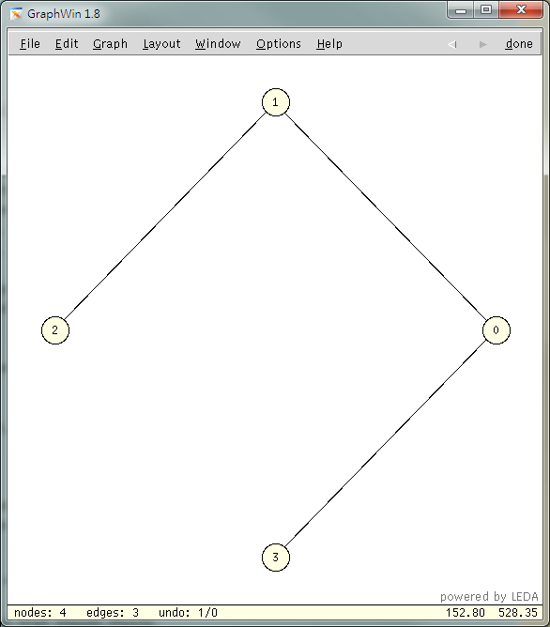
Create a GraphWin
GRAPH<int, int> G;
GraphWin gw;
//initial the graph
random_simple_undirected_graph(G, 4, 3);
Make_Connected(G);
//set graphwin
gw.set_graph(G);
gw.set_edge_direction(undirected_edge);
//show graphwin
gw.display(window::center,window::center);
gw.edit();

Slide 8
Graph
Elements in a Graph
Node set
Edge set
Node
Edge

Slide 9
Graph Representation
1
1
3
3
2
2

Slide 10
Graph Data Structure
Node
Node name
Neighbor
Serial number
Weight
Edge
Edge name
Serial number
Weight
Source
Sink
class NODE{
string name;
vector<NODE> neighbor;
int sn;
int weight;
};
class EDGE {
string name;
int sn;
int weight;
NODE source;
NODE sink;
};

Slide 11
Basic Graph Operation
Insert a node
Delete a node
Insert an edge
Delete an edge

Slide 12
Graphs
A
D
C
B
E
GRAPH<string, string> G;
node n_temp1, n_temp2, n_temp3, n_temp4, n_temp5;
n_temp1 = G.new_node(“A”);
n_temp2 = G.new_node(“B”);
n_temp3 = G.new_node(“C”);
n_temp4 = G.new_node(“D”);
n_temp5 = G.new_node(“E”);
G.new_edge(n_temp1, n_temp2);
G.new_edge(n_temp2, n_temp3);
G.new_edge(n_temp3, n_temp4);
G.new_edge(n_temp3, n_temp5);

Slide 13
Graph Traversal Example
Depth-First Search Bread-First Search
5→0→4→6→1→3→2
5→0→1→2→4→3→6
5
5
0
0
2
2
4
1
4
1
6
6
3
3

Slide 14
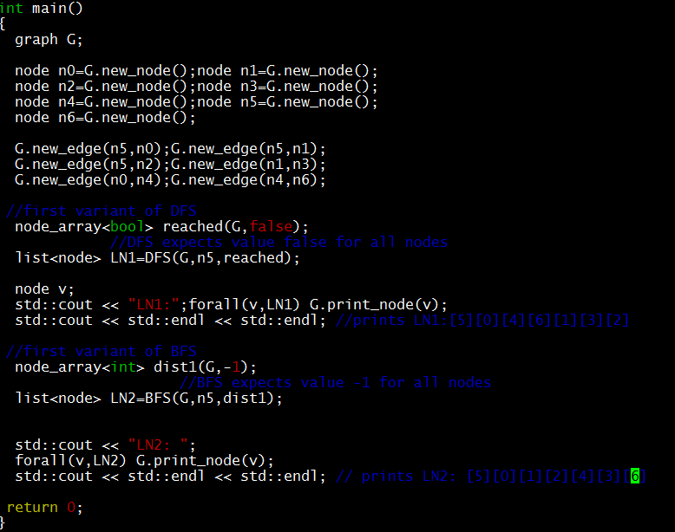
Example Code
Graph construction
DFS
BFS

Slide 15
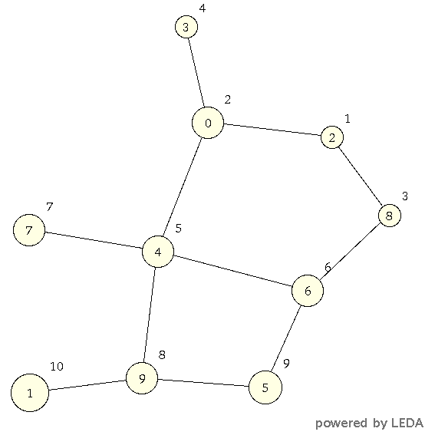
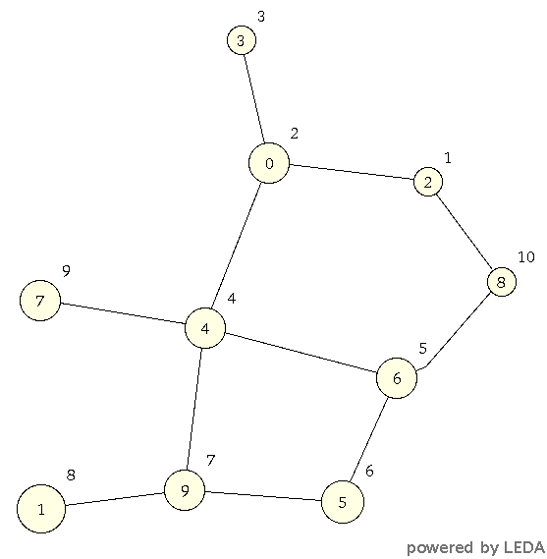
Graph Traversal Visualization
BFS
DFS

Slide 16
Min Cut Example
The minimum cut has value: 3
cut:[3][1]
0
1
1
3
2
2
3
2

Slide 17
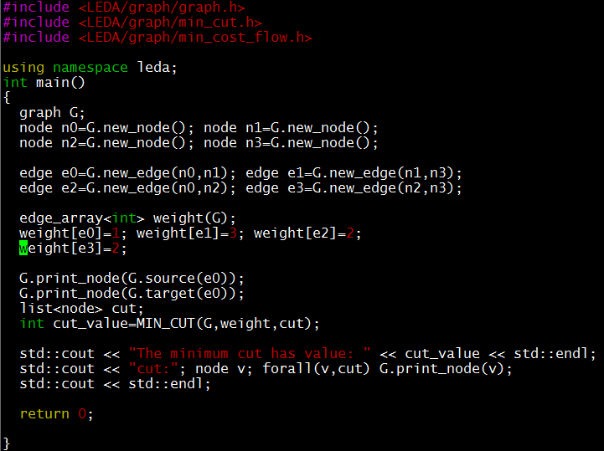
Example Code
Graph construction
Min cut algorithm

Slide 18
Outline
Introduction to LEDA
Basic data type
Graphs
GraphWin
Resources of LEDA

Slide 19
Resource of LEDA
LEDA Office Page
http://www.algorithmic-solutions.com/leda/
LEDA User Manual
http://www.algorithmic-solutions.info/leda_manual/manual.html
LEDA Guide
http://www.algorithmic-solutions.info/leda_guide/Index.html
The LEDA Platform of Combinatorial and Geometric Computing
http://www.mpi-inf.mpg.de/~mehlhorn/LEDAbook.html

Slide 20
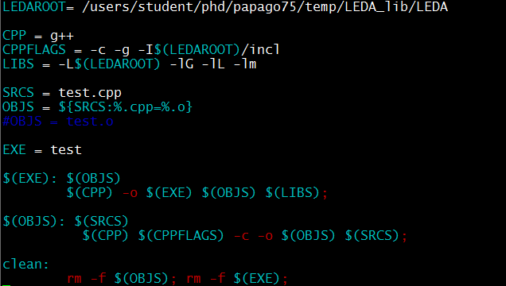
Compilation on Workstation
In NTHU-CAD
g++ -c –g -I/users/student/yourid/LEDA_lib/LEDA/incl -c -o test.o test.cpp
g++ -o test test.o -L/users/student//yourid/LEDA_lib/LEDA -lG -lL -lm;
g++ parameters
-I: location of the LEDA header files
-L: location the LEDA library files

Slide 21
Appendix

Slide 22
State Probability Calculation
11/1
25%
A
B
--/1
A
B
100%
0-/1
10/1
--/1
75%
100%
C
C
25%
36%
36%
A
B
100%
A + B + C = 1
B = A
0.25 * A + C = B
0.75 * A = C
75%
100%
C
27%

Slide 23
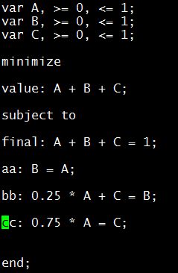
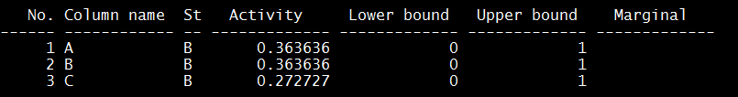
Linear Programming Solver
sample.mod
A + B + C = 1
B = A
0.25 * A + C = B
0.75 * A = C
./glpsol -m sample.mod -o sample.out
GLPK (GNU Linear Programing Kit)
sample.out

